Slide 1
Data Mining
Clustering
Imran Siddiqi
imran.siddiqi@mcs.edu.pk
Computer Science Department
College of Telecommunication Engineering
National University of Sciences and Technology

Slide 2
Clustering
Partition a set of records into groups such that records within a group are similar to each other and records that belong to two different groups are dissimilar
Each group is called a cluster
Similarity between records is measured computationally by a distance function

Slide 3
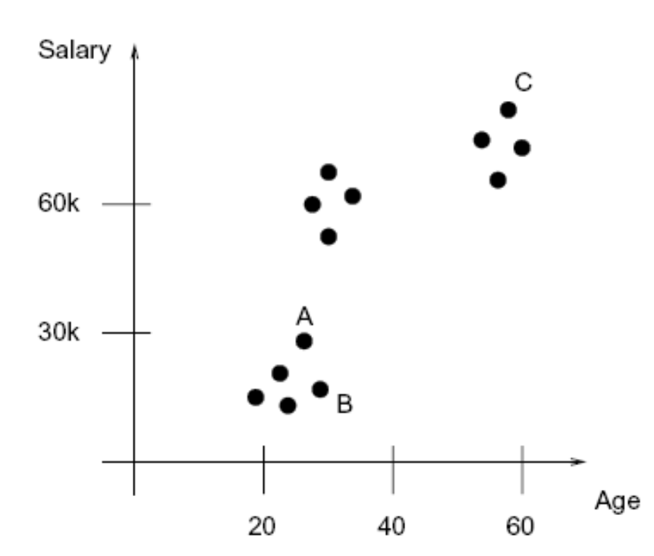
Clustering
CustomerInfo(age: int, salary: real)
B
Three Clusters
Young customers who have low salaries
Young customers with high salaries
Older customers with high salaries

Slide 4
Clustering
Summarized representation of each cluster
Spherical clusters
  Each cluster can be represented by its center (often also called the mean) and its radius

Slide 5

Case Study: Bank
Business goal: Sell more home equity loans
Current models:
  Customers with college-age children use home equity loans to pay for tuition
  Customers with variable income use home equity loans to even out stream of income

Slide 6
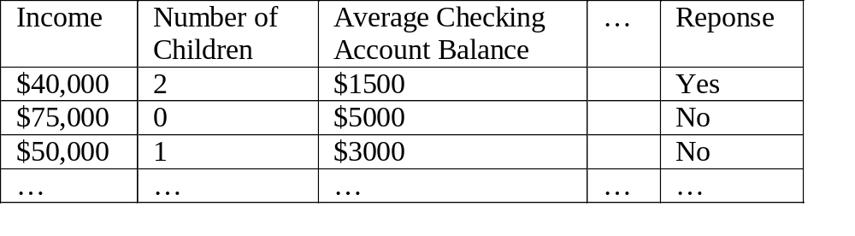
Case Study: Bank
Customer received home equity loan offer
  Customers who declined
  Customers who signed up

Slide 7
Case Study: Bank
Group customers into clusters and investigate clusters
Group 2
Group 3
Group 1
Group 4
Evaluate Clusters
Launch new Marketing Campaigns

Slide 8
Examples: Fraud Detection
Auto insurance: Detect groups of people who stage accidents to collect insurance
Medical insurance: Fraudulent claims
Money laundering: Detect suspicious money transactions

Slide 9
K-Means Clustering
Chose the number (K) of clusters and randomly select the centroids of each cluster.
For each data point:
  Calculate the distance from the data point to each cluster.
  Assign the data point to the closest cluster.
Recompute the centroid of each cluster.
Repeat steps 2 and 3 until there is no further change in the assignment of data points (or in the centroids).

Slide 10
K-Means Clustering

Slide 11
K-Means Clustering

Slide 12
K-Means Clustering

Slide 13
K-Means Clustering

Slide 14
K-Means Clustering

Slide 15
K-Means Clustering

Slide 16
K-Means Clustering

Slide 17
K-Means Clustering

Slide 18
K-Means Clustering

Slide 19
Clustering
What to do if the number of clusters is NOT known

Slide 20
Clustering
Compute the distance between record r and each of the existing cluster centers
Let i be the cluster index such that the distance d between r and C_{i} is the smallest
If d < Threshold
Assign r to cluster i
Else
Start a new cluster containing only record r

Slide 21
References
Reading material for these topics will be uploaded on the Learning Management System

